Slide 1
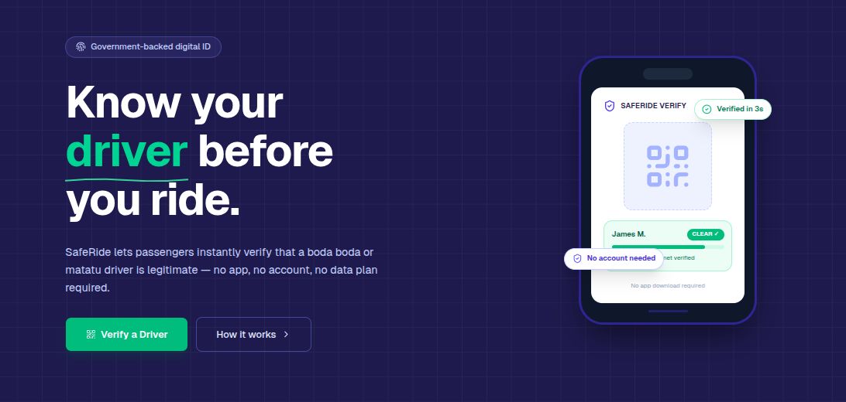
SafeRide
Africa Digital ID Hackathon use case

Slide 2



East Africa
Team introduction
Rwanda | SafeRide
Carnegie Mellon University - Africa
Joseph Ineza Karangwa
Marlyn Mayienga
Deku Mawuli

Slide 3
Use case introduction: Focus sector and the challenge that digital ID will solve.
SafeRide is a digital-ID-anchored trust overlay for informal transport that links every boda-boda rider and taxi driver to a verified government identity, letting any passenger confirm who they are boarding with before they get on.
Across East Africa, millions of passengers board boda-bodas and informal taxis with no way to verify who the rider is or whether the vehicle is legitimate. This anonymity enables impersonation, robbery, assault, and untraceable incidents. It disproportionately affects women, students, and night commuters. In Kenya alone, 71.9% of motorcycle-related crimes involve casual commission riders with no accountability trail.
01
02
SafeRide provides enrolled drivers with a secure digital badge linking their verified identity to an approved vehicle. Passengers can verify the driver before the trip using QR code, NFC, or USSD. Suspended drivers' badges are instantly unverifiable. Passengers can also share trip details with trusted contacts for emergency safety.
03
SafeRide uses MOSIP's digital ID for trust. Drivers enroll via eSignet, verifying national identity with biometrics or OTP. Inji Certify issues a signed Verifiable Credential linking the driver to the vehicle, stored in the Inji Wallet. Passengers verify offline using Inji Verify. Driver privacy is protected: a revocable Virtual ID is used instead of their real ID.

Slide 4
Problem statement: Provide a short description of the problem
Informal transport operators across East Africa have no verifiable digital identity, leaving passengers with no reliable way to confirm who they are boarding with. This anonymity fuels impersonation, assault, robbery, and untraceable crimes against millions of daily commuters.
What is the current process for accessing benefits, completing transactions, or engaging with systems? Passengers currently board boda-bodas and informal taxis based entirely on visual trust. There is no standard verification process. In some areas, SACCOs and stages issue physical membership cards or badges, but these are paper-based, easily forged, and not linked to any national identity record. A passenger has no way to confirm whether the person in front of them is who they claim to be, whether the vehicle is registered to that rider, or whether that operator has a history of misconduct.
What barriers do citizens or businesses face in this process, and who is most affected? Passengers have no accessible tool to verify operator identity before boarding. Feature phone users and those without data access cannot use existing app-based safety solutions like Uber or SafeBoda, which also exclude informal operators through commission models and smartphone requirements. Women, students, night commuters, and people in peri-urban and rural areas are most exposed, as they rely heavily on informal transport and have the least recourse when incidents occur.
How does the absence of an integrated digital ID cause or worsen these barriers? Without a digital identity layer, there is no way to de-duplicate operators, confirm authenticity of a badge, or link a rider to a specific vehicle. An operator can register under a false name at multiple stages. A suspended or criminal rider can continue operating because there is no shared revocation system. Incident investigations stall because there is no verifiable record connecting a rider to a trip. The absence of digital ID means accountability does not exist at any point in the transaction.
What is the scale and urgency of this problem? Kenya's boda-boda sector alone is valued at KES 660 billion annually, representing 4.4% of GDP, with millions of daily trips taken by ordinary citizens. Kenya's National Crime Research Centre found that 71.9% of motorcycle-related crimes involve casual or commission riders and 66.5% involve rented motorcycles with no adequate identity checks. Uganda Police documented an organised taxi gang responsible for the abduction and murder of female passengers in Kajjansi. These are not isolated incidents but regional patterns driven by a structural identity gap that affects every informal transport user across East Africa every single day.

Slide 5
Proposed solution overview
SafeRide is a digital trust overlay for informal transport. We enroll boda-boda riders and taxi drivers through their national identity system and issue each operator a cryptographically signed digital credential tied to their verified identity and authorised vehicle. This credential is displayed as a QR code on a tamper-resistant badge on the vehicle. Before boarding, any passenger can scan the badge or dial a short USSD code to instantly see whether the operator is verified, active, and matched to the vehicle in front of them. Suspended or flagged operators are immediately unverifiable. Passengers can also share trip details with trusted contacts in one tap.
01
SafeRide enrolls boda-boda riders and taxi drivers through their national identity system and issues each operator a signed digital credential tied to their verified identity and authorised vehicle. Before boarding, any passenger scans a QR badge or dials a USSD code to instantly confirm the operator is verified, active, and matched to the vehicle in front of them. Suspended or flagged operators are immediately unverifiable.
02
Operators are authenticated through eSignet, which verifies their national identity using biometrics or OTP, and Inji Certify issues a Verifiable Credential binding the operator to their vehicle. That credential lives in the driver's Inji Wallet and can be verified offline by a passenger using Inji Verify with no live server connection required. A revocable Virtual ID is used on the badge instead of the real national ID, so if a badge is stolen it can be invalidated without affecting the operator's national identity.
03
SafeRide is the only transport safety solution that works across QR, NFC, USSD, SMS, and voice, reaching passengers with feature phones and no data. Real-time status management by SACCOs, consent-based data disclosure, emergency trip sharing, and a stage leader portal for passengers without any phone make it fully inclusive. No other solution serves informal operators and low-resource passengers simultaneously.
04
The country must have an active MOSIP national ID deployment, which is already the case across several East African countries. Transport associations and SACCOs must serve as enrollment points, which is feasible since they already govern their members and benefit from a trusted operator reputation. For operators without smartphones, a physical badge with a signed QR code and USSD fallback is sufficient for the system to work.

Slide 6
Information flow (Technical)
Provide a brief overview of your prototype’s technical framework, highlighting key components and illustrating how data flows through the system. It may include some of the below mentioned components
System Diagram
Tech stack description
Data model and design
Key tools utilized: List any specific libraries or SDKs used (e.g., MOSIP modules)

Slide 7
User journey flow
Show the detailed step-by-step process for a user using your solution in a real-world scenario using icons/ figures. One dummy example given below
Amara, a female student, approaches a boda-boda stage late at night and wants to verify her rider before boarding.
She opens her phone camera and scans the QR code on the rider's badge.
The rider receives a prompt on his Inji Wallet asking him to confirm the sharing request.
The rider authenticates using his fingerprint on his phone, giving consent to share his credential.
Amara's screen displays the verified trust bundle — name, photo, ACTIVE status, and linked motorcycle plate.
She confirms the face on screen matches the rider in front of her and that the plate matches the motorcycle.
Reassured, she boards. She taps "Share This Ride" and sends a link with the rider's details to her mother via WhatsApp.
If anything goes wrong, her mother has the rider's verified identity and can share it with police immediately.

Slide 8
Potential Impact
5million
Boda-boda operators across East Africa, serving tens of millions of daily passengers with zero identity verification infrastructure in place.
4.8 million
Women passengers — the primary documented targets of boda-boda assault and sexual violence across Kenya and Uganda, with no current tool available to verify operator identity before boarding.
1,244
Motorcycle-related deaths in Kenya in 2020 alone, in a sector where riders operate anonymously and incidents go uninvestigated due to no verifiable identity trail. (Kenya NTSA)

Slide 9
Challenges and stakeholder mapping
A stakeholder is an organization, agency, or individual (private or public) other than your team that has a specific interest in your focus sector and is relevant and/or can support the implementation of your solution
Challenges | Solution | Stakeholder
Drivers and SACCO officers may distrust a new digital system, especially those unfamiliar with smartphone apps or formal ID processes. | Run pilot enrollments at one willing stage with trusted SACCO leaders as champions. Use peer demonstration rather than top-down instruction. | Boda-boda SACCOs and transport stage associations such as the Boda Boda Association of Kenya and UTODA in Uganda.
National ID coverage is incomplete in some areas, meaning not all operators can be enrolled immediately. | Allow phased enrollment starting with operators who already have national IDs, while partnering with ID authorities to fast-track registration for the unregistered. | National identity agencies such as Kenya's NIIMS, Uganda's NIRA, and Rwanda's NIDA.

Slide 10
Thank you

